Slide 1
Experiences in the past
23. Past perfect simple

Slide 2
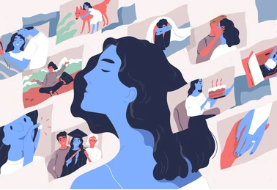
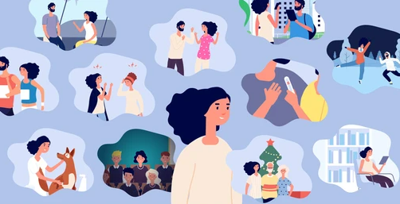
Past experiences
What did you do before working for Hexaware?
Do you remember university?
What did you do before university?
What did you do in elementary school?
What was you favorite meal when you were a kid?

Slide 3
Review past participles
Buy | Go | Have | Give | Think
Make | Get | Show | Pay | Spend
Know | Take | Eat | Be | Put
Run | Swim | Break | Send | Bring
Notes:
Buy-bought
Go-gone
Have-had
Give-given
Think-thought
Make-made
Get-gotten
Show-shown/showed
Pay-paid
Spend-spent
Know-known
Take-taken
Eat-eaten
Be-been
Put-put
Run-run
Swim-swum
Break-broken
Send-sent
Bring-brought

Slide 4
Past perfect
Subject + HAD + past participle = he had done it before.
We use the Past Perfect Simple to talk about an action that happened before another action in the past.
The action that happened first is in the Past Perfect Simple. The later action is in the Past Simple.
We often use time expressions like when, after, before, and by the time with the Past Perfect Simple to emphasize the earlier action.
We had talked about buying a new camera before we went to the electronics store.
We decided to buy a new TV after we had looked at all the TVs in the store.

Slide 5
Complete with the verbs in past participle
see, eat, lie, forgive, grow, awake, study, win, show, fall
Mary had _____ and begun working long before the alarm went off.
He had never _____ a hamburger in his life.
We had _____ and respected every ethnic background in America.
We’d _____ one of the guards sitting on a horse before.
Players under 30 had ____ only six tournaments when I joined.
Judges frequently had _____ criminals for their actions.
She had _____ me the August moon light on the ocean. It was lovely
He was about to tell the judge that he had _____ about acting alone.
Trees had _____ and thousands of people were without electricity.
We had 12 acres of certified organic tomatoes which we had _____ for seed.
Notes:
Awoken
Eaten
Studied
Seen
Won
Forgiven
Shown
Lied
Fallen
Grown

Slide 6
Choose the correct one
After / By the time / Later they got to the electronics store, all the shop assistants had gone home.
I returned the earphones to the store already / the next day / after I had had them for a week.
Peter had been to many electronics stores when / while / after he suddenly found the MP4 player he wanted.
Had you decided how much to spend before / at the moment / during you went shopping for a DVD player?
By the time I graduated, I had already / the next day / after finished my internship.
I had gotten my engineering degree when / while / after I realized I had to study a lot more than my Bachelors.
Notes:
By the time
After
When
Before
Already
When

Slide 7
Use these verbs to create a sentence
Example:
I had worked from home before the pandemic started.
The uber arrived after we had gotten prepared.
Bought | Gone | Had | Given | Thought
Made | Gotten | Shown | Paid | Spent
Known | Taken | Eaten | Been | Put
Run | Swum | Broken | Sent | Brought

Slide 8



Tell your friends about your background
Before I worked for Hexaware…
By the time I graduated…
When I started University…

